Slide 1

M.N.S.L.A.C
Mesh Networks for Simultaneous Localization and Communication
Team 1961C
Kevin Abraham
Yassine Bennani
Sai Molugoori
Keenan Nicholson
Norris Nicholson
Notes:
Sai

Slide 2
Project Overview
Design a cost-effective waterproof technological system to replace GPS modules for real time tracking of sailboats during regattas for audiences at shore.
Mesh network of radios that utilize distance measurement and triangulation algorithm techniques to convey locations to base stations.
Cost of entire system was approximately $500.

Slide 3
Overall Design Objectives
Securely attach nodes consisting of electronics to the top of the mast
Continuously receive packets from all active nodes
Use incoming node data to display real time location of boats on web app and base station interface

Slide 4
Key Design Specifications
Radio Systems
Project Element | Category | Specifications
Radio Systems | Localization | Accuracy of 7 feet or better
 |  | Measurements every 3 seconds
 | Communications | Range not less than 300 feet
 |  | Adequate data transfer rate
 |  | Must be able to relay messages to other nodes as needed
 | Network | Operates with 1 to 12 nodes
 |  | Operates with as little as 1 base station + extender
Notes:
Keenan

Slide 5
Key Design Specifications
Base Station
Project Element | Category | Specifications
Base Station | Enclosure | No larger than 10”x6”x6”, no heavier than 5 lbs
 |  | Must be mountable to a tripod
 | Antenna | Securely mounted to the enclosure (inside or out)
 | Power | Must be powerable from AC power or an internal battery
 |  | Internal battery must last 6 hours and charge in 8 hours
 | Interface | Must host a Wi-Fi network for displaying node locations
 |  | Must include settings relevant to system operation
Notes:
Keenan

Slide 6
Key Design Specifications
Base Station Extender
Project Element | Category | Specifications
Base Station Extender | Enclosure | No larger than 8”x5”x5”, no heavier than 3 lbs
 |  | Must be mountable to a tripod
 | Antenna | Securely mounted to the enclosure (inside or out)
 | Power | Must be powerable from AC power or an internal battery
 |  | Internal battery must last 6 hours and charge in 8 hours
 | Interface | Have internal buttons/indicators as needed for operation
 |  | Be controllable from the base station
Notes:
Keenan

Slide 7
Key Design Specifications
Node
Project Element | Category | Specifications
Node | Enclosure | No larger than 8”x5”x5”, no heavier than 3 lbs
 |  | Water resistant to a depth of 25 feet for up to 5 minutes
 | Antenna | Securely mounted to the enclosure (inside or out)
 | Power | Run for up to 4 hours and charge in less than 6 hours
 |  | Withstand temperatures between 40 °F and 130 °F
 | Interface | Have internal buttons/indicators as needed for operation
 |  | Be controllable from the base station
Notes:
KeenanKeenan

Slide 8
Design Approach and Details
Notes:
Sai

Slide 9
Power Supply
Antennas
18650 Battery (node)
Thermal and volumetric efficiency
Higher charge cycle count (~1800)
Cheaper
Portable Battery Pack (base)
Omni-directional (node)
Loop or Dipole
Directional Antenna (base)
End-fire or Yagi-Uda
Testing phase
DWM1000 module integrated antenna
Notes:
Sai / Kevin

Slide 10
Radio Transceiver
Microcontrollers
DW1000
Onboard ToF hardware
Supports communication between modules
Testing phase
DWM1000 modules (integrated antenna) with pins broken out to a breadboard
Final Development
Custom PCB integrating DW1000, RF electronics, external antenna connection
AVR vs. ARM vs. Xtensa RISC
Library compatibility
Processing speed
Power consumption
Final Design Considerations
AVR and ARM-based microcontrollers can be integrated into the PCB
Modules from Espressif would be soldered to the PCB as is

Slide 11
Product Design
Custom designed PCB board with microcontroller and DWM1000 radio module along with required components such as external crystal, resistors, capacitors, and diodes.
Waterproof cases to hold PCB boards, battery powering electronics, and radio to receive and send signals.
Base station to receive/process data and display to audience watching the regatta.
Algorithm to use known locations of nodes to find location of nodes not in the range of two base stations.

Slide 12
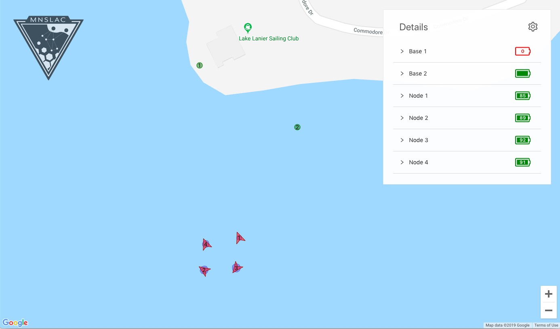
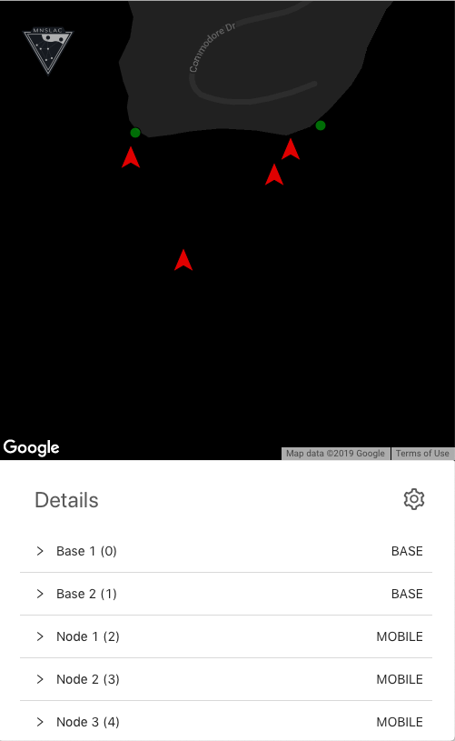
Algorithm
ToF
ToF
Algorithm
ToF
Notes:
Kevin

Slide 13
Localization
Methods
Mesh Network
Localization Area
Direct Triangulation Area
Notes:
Kevin

Slide 14
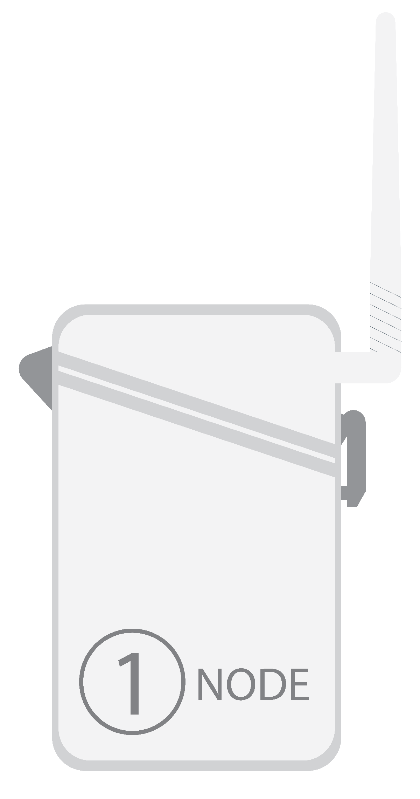
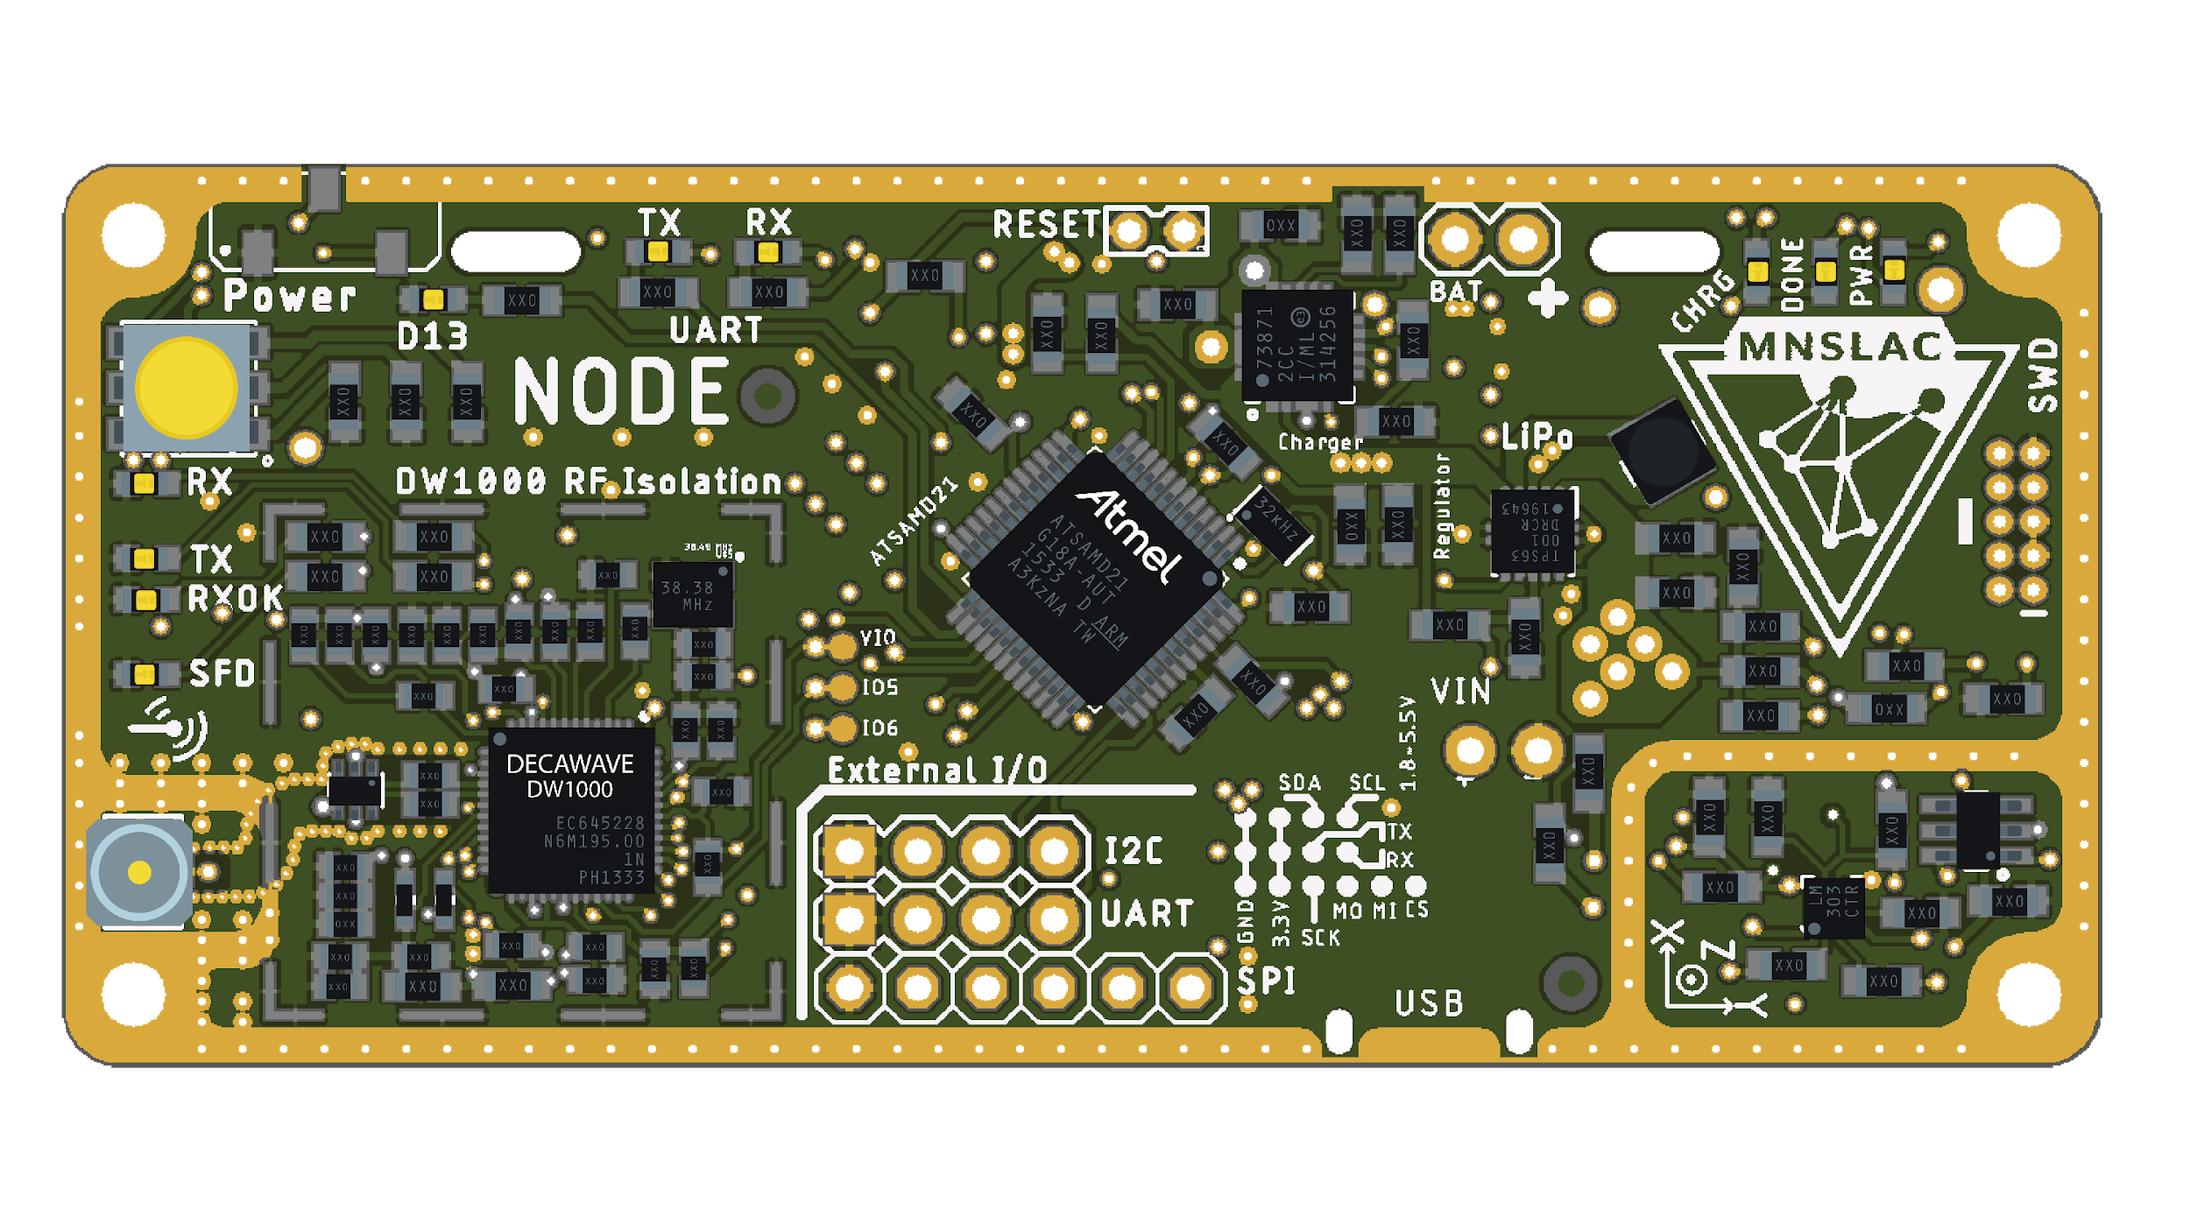
PCB Design
Notes:
Chat briefly about each component

Slide 15
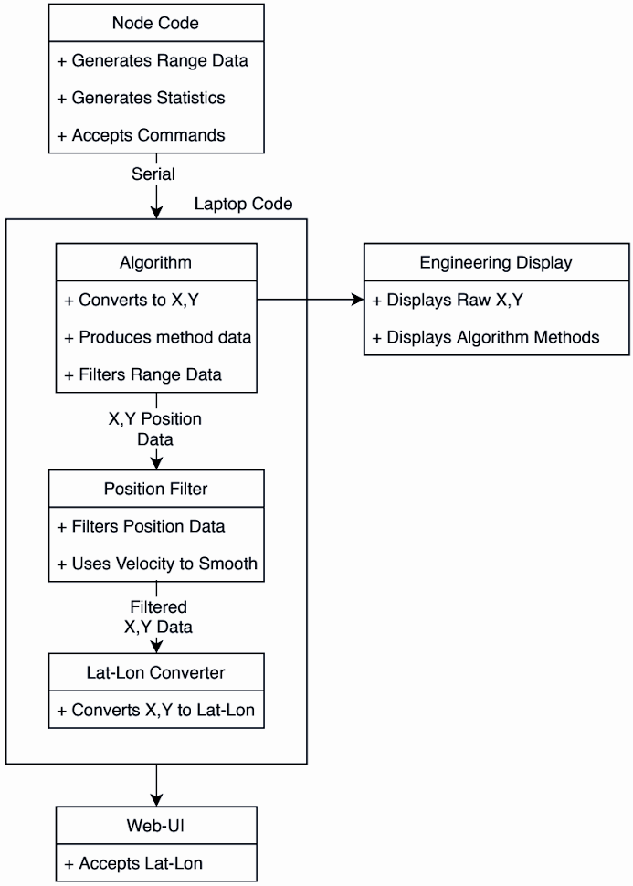
System Code
Overview

Slide 16
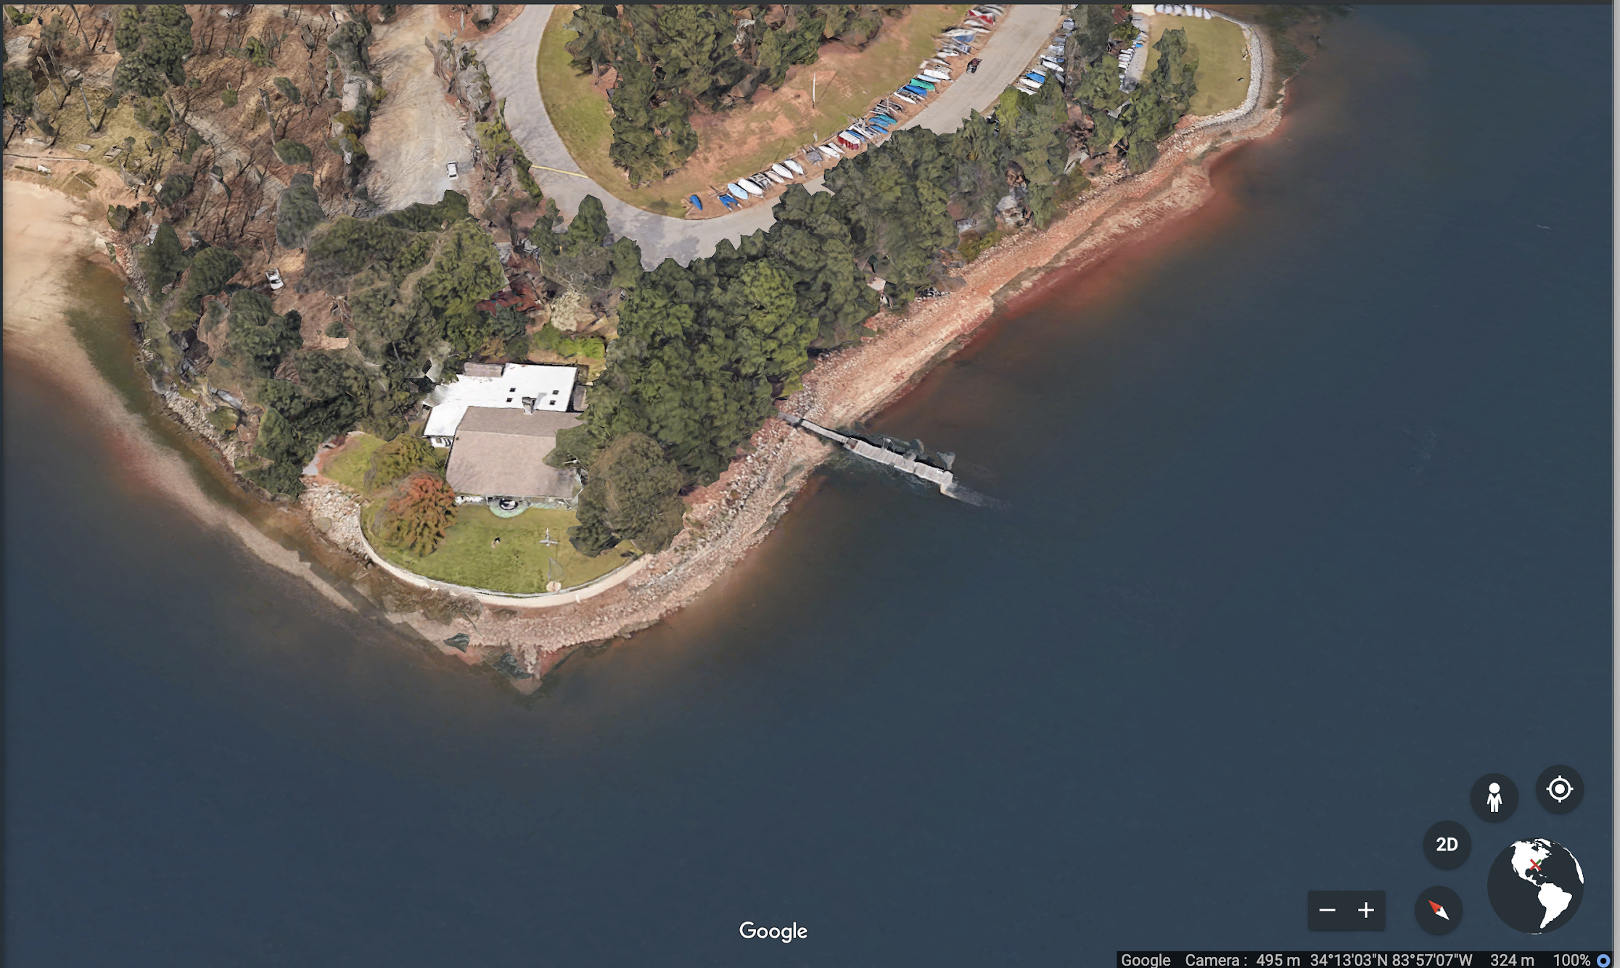
Project Demonstration
Georgia Tech Sailing Club at Lake Lanier
Nodes were placed on C420 sailboats
One base station was placed on shore while the extender pair was on the dock (red dots)
Sailboats were out on the Lake cruising
Notes:
Norris

Slide 17
Testing Parameters
Both base stations must be communicating with each other
Node must be seen by both base stations before venturing off
Minimum number of packets should be received for connection to be considered successful
Notes:
Acceptance Testing

Slide 18
Results
Minimum Range | ~ 5 meters
Maximum Range | ~ 300 meters
Refresh Rate | 1.5 Hz
Avg. number of packets per cycle | 30
Waterproof | Successful

Slide 19

Results - Meshing Algorithm

Slide 20
Project Challenges
Antenna that operated at desired frequency
Soldering all components on PCB board
Node message timing and synchronization
Packets queuing due to running multiple threads on main
Reliable and accurate meshing algorithm

Slide 21
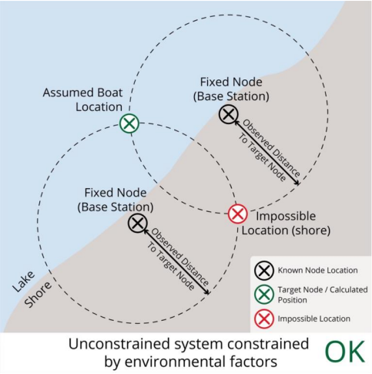
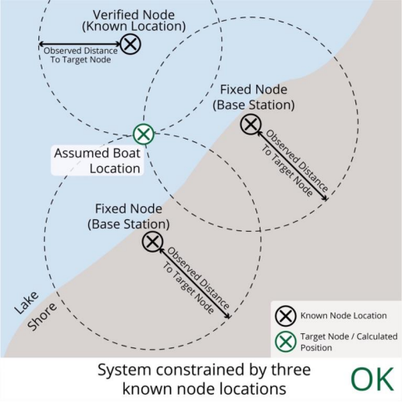
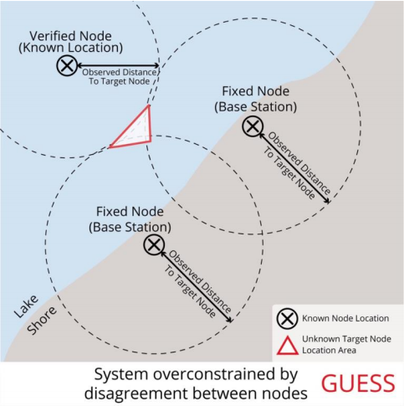
Challenge - Overconstrained Localization
Notes:
Kevin
Notes: In reality, we found that the accuracy of measurements was very good. The last case is very rare, especially with the filtering we do. The harder part is figuring out which guesses are wrong

Slide 22
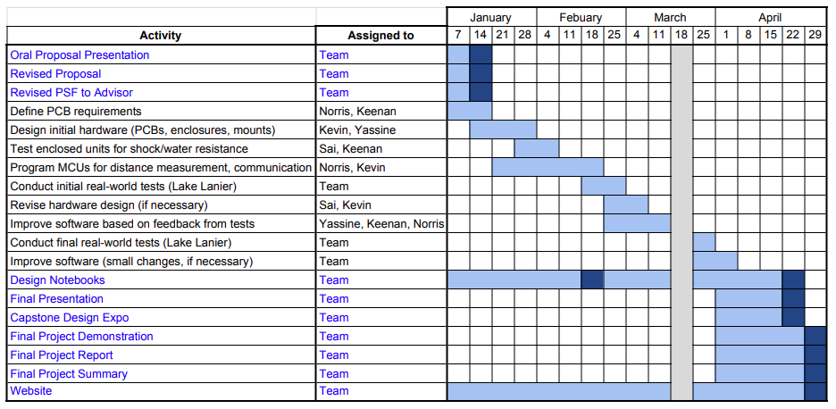
Schedule, Tasks, and Milestones
Notes:
Norris

Slide 23
Current Status
Base stations can successfully receive packets from nodes and display on the web and mobile app.
Time of flight calculations give accurate distance measurements with an error of few centimeters.
Antennas are calibrated to decrease the amount of error
Algorithm uses nodes to create mesh network and detect other nodes that base station cannot detect directly.
Notes:
Yassine

Slide 24
Next Steps
Build more nodes and conduct tests on a larger scale.
Buy better antennas to optimize the range of our network.
Increase the overall efficiency of meshing algorithm.
Sturdier mounting platform for both base stations.
Obtain band licensing and increase transmit power
Notes:
Yassine

Slide 25
Questions?

